Slide 1
Simulated Annealing
Metaheuristic method for solving global optimization problems

Slide 2
Presentation index
Mathematical background
Parallel implementation
Application design
Code implementation
Performance results

Slide 3
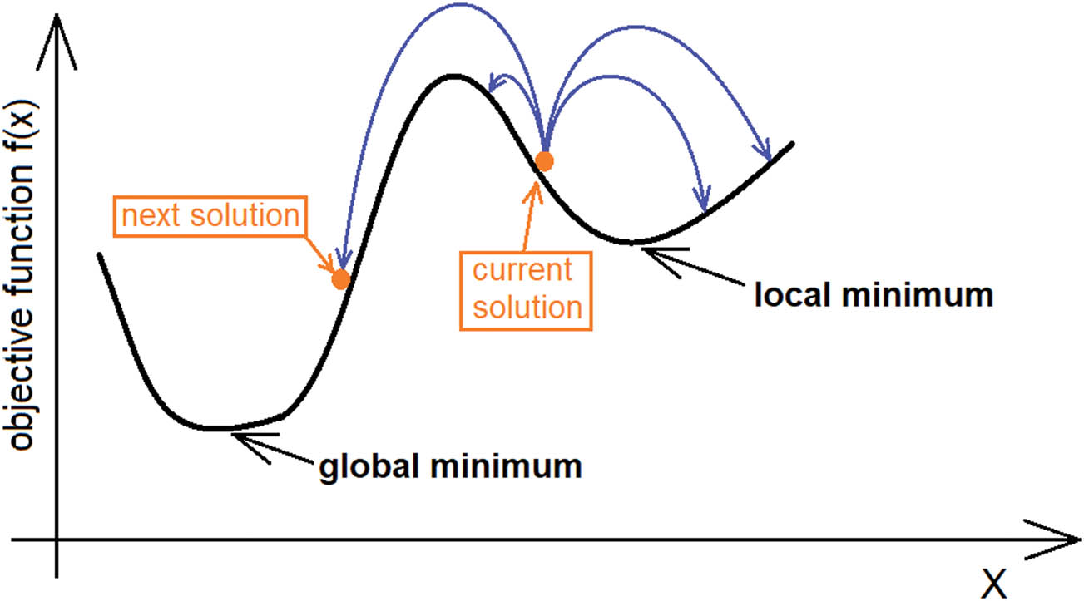
Mathematical background
Simulated annealing is one of the simplest and best-known metaheuristic methods for solving global optimization problems. It aims to find the global optimum of a non-convex function. In our case, we use the simulated annealing to find the global minimum of a function.
Notes:
Simulated annealing is one of the simplest and best-known metaheuristic methods for solving global optimization problems. It aims to find the global optimum of a non-convex function.
The name comes from annealing in metallurgy, a technique involving heating and controlled cooling of a material to alter its physical properties.
In our case, we use the simulated annealing to find the global minimum of a function.

Slide 4
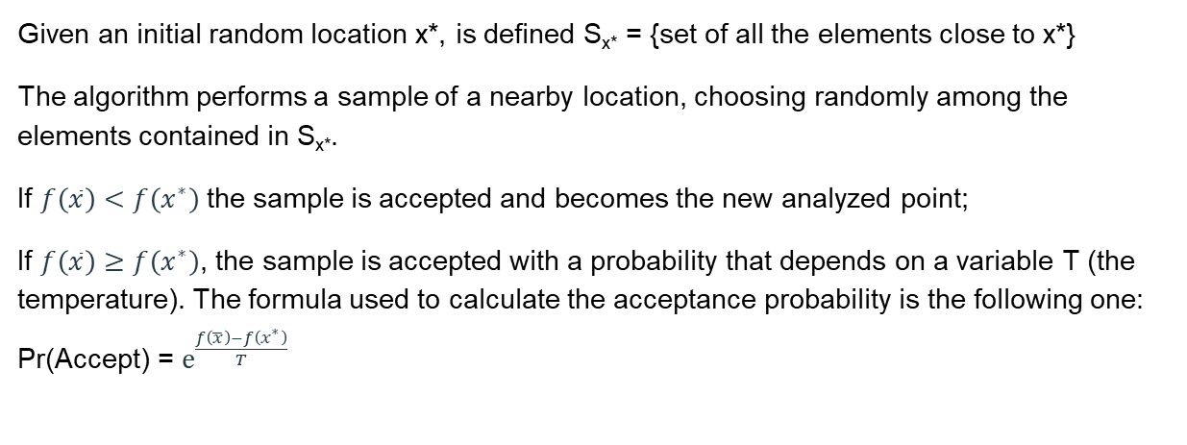
Mathematical background
Given an initial random location x*, is defined S_{x*} = {set of all the elements close to x*}
The algorithm performs a sample of a nearby location, choosing randomly among the elements contained in S_{x*}.
If $f\left(\overline{x}\right)<f\left(x^{∗}\right)$ the sample is accepted and becomes the new analyzed point;
If $f\left(\overline{x}\right)≥f\left(x^{∗}\right)$, the sample is accepted with a probability that depends on a variable T (the temperature). The formula used to calculate the acceptance probability is the following one: Pr(Accept) = $ⅇ^{\frac{f\left(\overline{x}\right)−f\left(x^{∗}\right)}{T}}$

Slide 5
Mathematical background
The algorithm starts with a high value of temperature, so that it will accept also moves that increase the objective function, and then progressively decreases.
The optimum research is stopped when the variable T goes under a certain tolerance.
For each value assumed by the variable T, are going to be performed L sampling and after those sampling, T will be decreased by multiplying it for a new value α ∈ (0.8, 1).
The idea is that, as the number of iterations grows, the probability to be in a local minimum is lower, so we should be careful to accept a new point that makes worse the solution.

Slide 6
Pseudocode
T = T₀
while T > tolerance
do L iterations with this Temperature
generate point close to x*
Accept/refuse the new point
end
Update (decrease) T
end

Slide 7
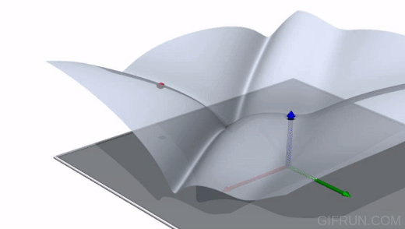
Animated example
We report here an animation that shows how the algorithm should work

Slide 8
Parallel implementation
Usually, to obtain a more accurate solution, the sequential algorithm is performed starting from multiple points and choosing the results given by the best solution.
The parallel implementation is based on performing the execution of the algorithm on multiple initial points at the same time. The used strategy may be described as follows:
The MPI program initially generates P processes that have ranks 0, ..., P-1;
Each process generates a random starting point and a random stepsize;
Each process executes the sequential algorithm;
At the end of the sequential algorithm, each process sends the obtained results to the process with rank 0. The process with rank 0, collects all the results and keeps just the best one;
If the number of points on which has been performed the algorithm matches the one provided by the user, the results are displayed on the screen, else return to point 2 maintaining alive the necessary processes to cover the remaining points.

Slide 9
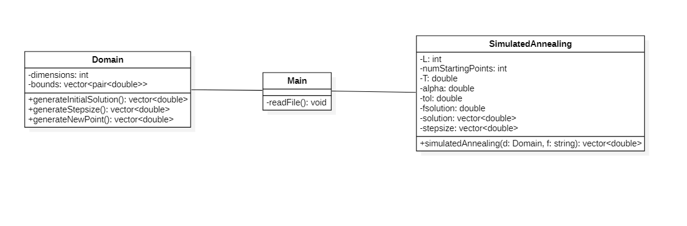
Application design

Slide 10
Main
It reads the input file, instantiates the domain, and starts the Annealing algorithm.
The input file is a text file structured as follows:
The first row represents the function: from the main point of view is a string, that will be processed by muparser (see next slides)
The second row indicates the number of dimensions of the domain
Following rows contain pairs of double and represent the domain bounds for each dimension.

Slide 11
Function parsing
The tool that we use to evaluate the function in different points is muParser.
First of all, we create an object of type mu::Parser and then we assign the function using the provided method “SetExpr”.
Our function has a different variable for each dimension. Those variables are called in the input file x1, x2, …, xn.
To evaluate the function in a certain point we need to assign the coordinates to each variable and then run the eval() method provided by the muParser library.

Slide 12
Domain
This class holds all the informations regarding the domain on which is evaluated the function.
It has several methods that are helpful during the execution of the simulated annealing algorithm, such as:
generateInitialSolution(), it generates a random starting point into the domain;
generateStepsize(), it generate the maximum step that is possible to do from the starting point to obtain a neighbor point;
generateNewPoint(std::vector<double> currentPoint, std::vector<double>& stepsize), it generates a new point close to the one provided as parameter.

Slide 13
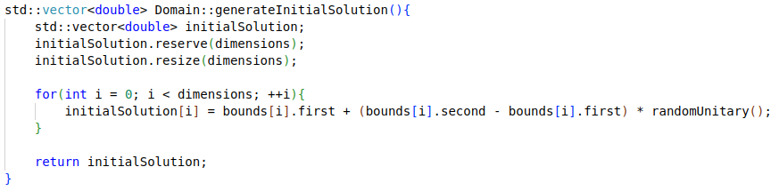
generateInitialSolution()

Slide 14
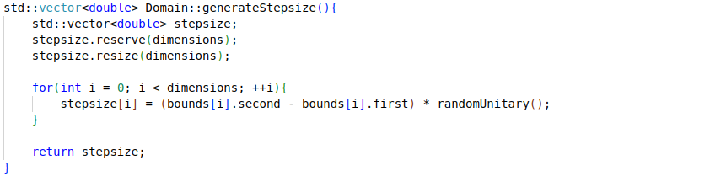
generateStepsize()

Slide 15
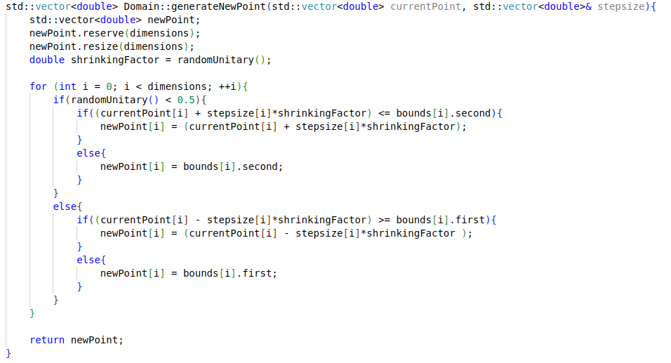
generateNewPoint()

Slide 16
SimulatedAnnealing
This class contains the actual methods that give us the possibility to perform the simulated annealing. Before starting the computation, we initialize the class with a set of values used during the execution, such as:
L, the number of iterations performed for each value assumed by the temperature;
T, the temperature;
alpha, the temperature reduction factor - after L iterations, we perform T = T * alpha;
tol, the tolerance under which the algorithm stops its execution;
fsolution, the evaluation of f in the current point;
solution, the best point obtained during the execution;

Slide 17
SimulatedAnnealing
The methods associated to the class are:
findMinimum(Domain domain, mu::Parser parser), that performs the core part of the Simulated Annealing algorithm on a single point;
exchangeData(int& dimensions, int& numCurrentPoint), that performs the exchange of data among the different processes;
simulatedAnnealing(Domain domain, std::string function), that performs:
findMinimum() as many times as the number of points assigned to each MPI process;
exhangeData().
The first 2 methods are actually private methods.

Slide 18
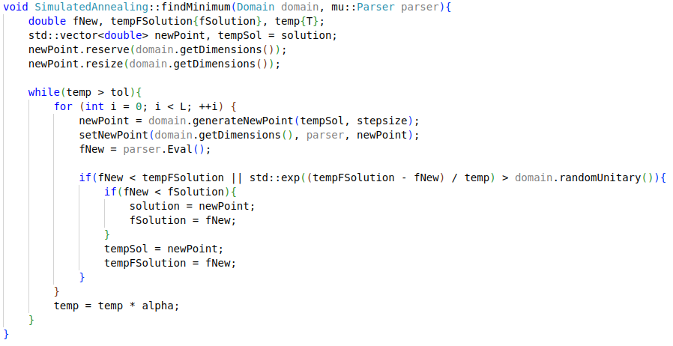
findMinimum()

Slide 19
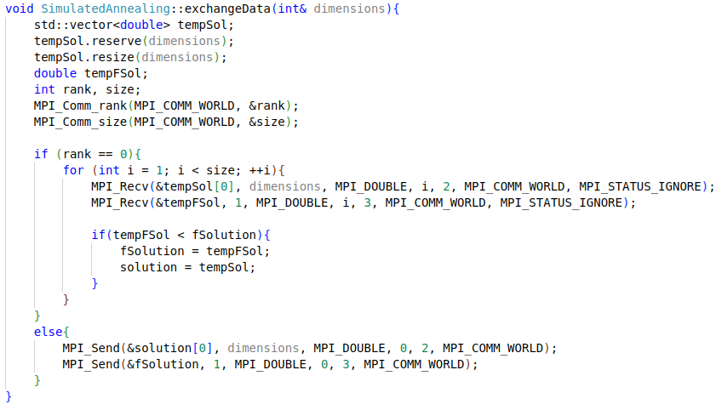
exchangeData()

Slide 20
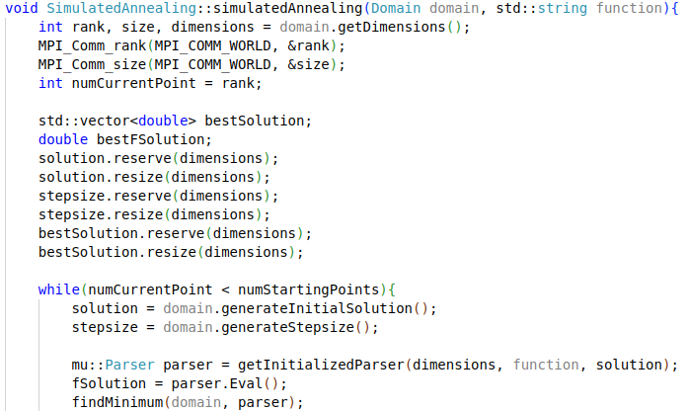
simulatedAnnealing()

Slide 21
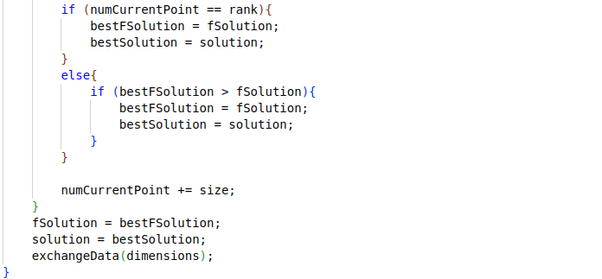
simulatedAnnealing()

Slide 22
Performance Analysis
We have considered 2 functions as benchmark, both in 2 dimensions.
The algorithm has been tested on them, with the following conditions:
Start from 7 different points
Starting Temperature = 200
alpha = 0.95
L = 1000
tolerance = 0.001

Slide 23
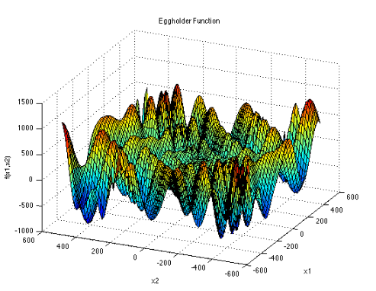
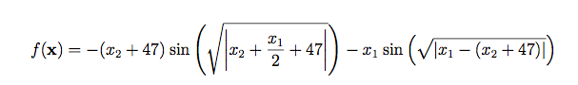
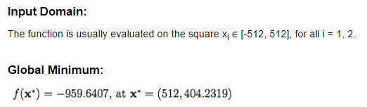
Function 1

Slide 24
Function 1
Function 1
# Processes | Result (X1, X2) |  | Elapsed Time
1 | 512 | 404,232 | 57,9144
2 | 512 | 404,232 | 37,4135
3 | 512 | 404,232 | 30,2342
4 | 512 | 404,232 | 23,524
5 | 512 | 404,232 | 23,4419
6 | 512 | 404,232 | 23,9099
7 | 512 | 404,232 | 15,55
As we can see, the result is correct and the performance is increased when the number of processes grows

Slide 25
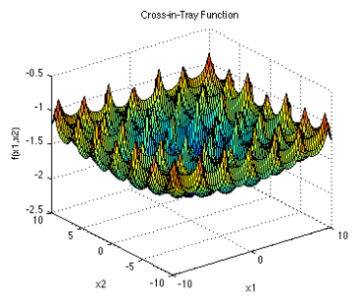
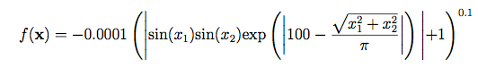
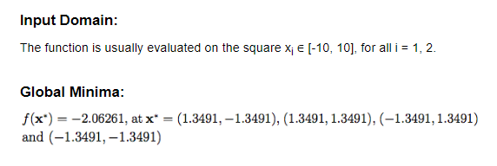
Function 2

Slide 26
Function 2
Function 2
# Processes | Result (X1, X2) |  | Elapsed Time
1 | 1,35185 | 1,35185 | 66,9142
2 | 1,34883 | -1,3489 | 39,7818
3 | 1,34883 | -1,3489 | 32,528
4 | 1,34883 | -1,3489 | 24,5709
5 | 1,34883 | -1,3489 | 24,948
6 | -1,34888 | -1,35066 | 25,2112
7 | -1,34888 | -1,35066 | 16,7335
As we can see, the result is very close to the actual minimum point, and the performance increases as the number of processes grows

